Slide 1
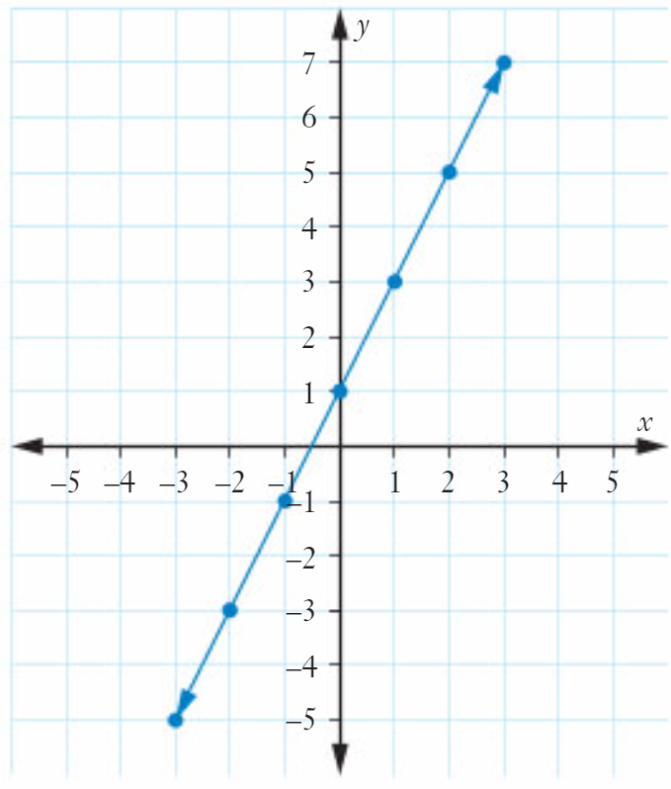

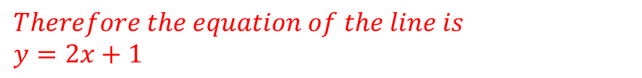
What’s my rule
The straight line with the rule $y=mx+c$
has $a gradient of m$
and $cuts the y−axis at the point (0,c)$
This line has a gradient of 2
For each move of 1 to the right, the line rises by 2.
It also cuts the y-axis at (0,1).
$$Therefore the equation of the line is$$
$$y=2x+1$$

Slide 2
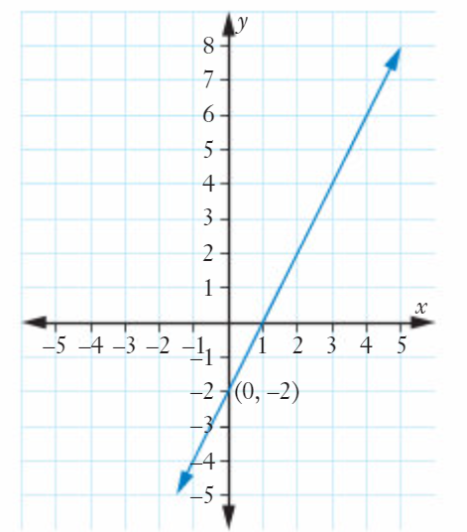

What’s my rule
The straight line with the rule $y=mx+c$
has $a gradient of m$
and $cuts the y−axis at the point (0,c)$
This line has a gradient of 2
For each move of 1 to the right, the line rises by 2.
It also cuts the y-axis at (0,-2).
$$Therefore the equation of the line is$$
$$y=2x−2$$

Slide 3
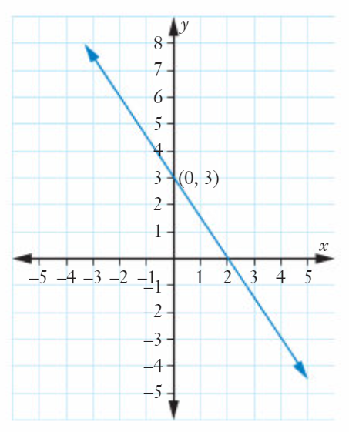
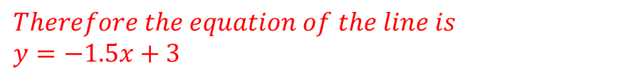
What’s my rule
The straight line with the rule $y=mx+c$
has $a gradient of m$
and $cuts the y−axis at the point (0,c)$
This line has a gradient of -1.5
For each move of 1 to the right, the line drops by 1.5.
It also cuts the y-axis at (0,3).
$$Therefore the equation of the line is$$
$$y=−1.5x+3$$

Slide 4
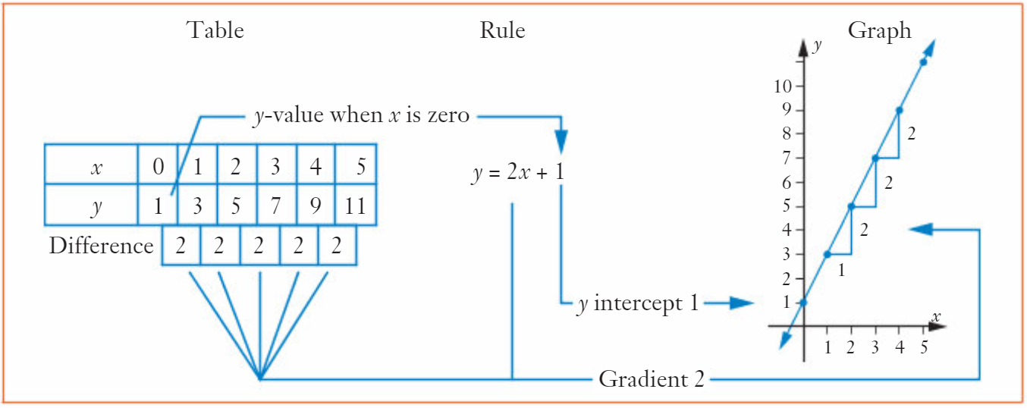
Table – Rule - Graph
The straight line with the rule $y=mx+c$
has $a gradient of m$
and $cuts the y−axis at the point (0,c)$

Slide 5
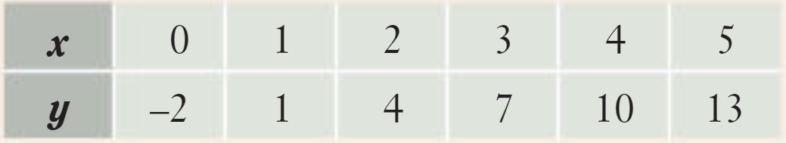
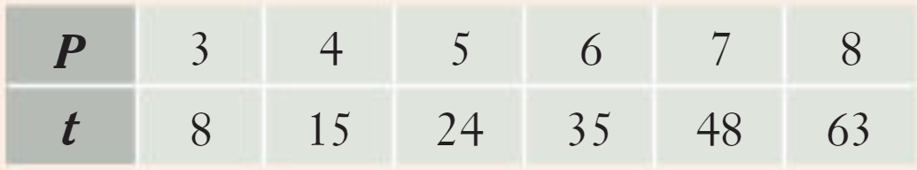
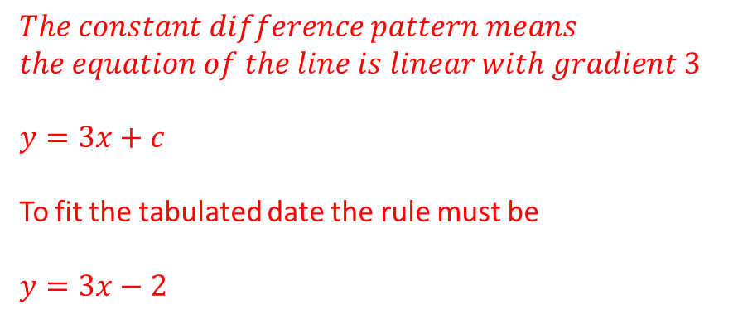

Example 1
Now try Exercise 8B
For each of the following tables determine whether the relationship between the two variables is linear and, for any that are, determine the rule.
1
1
1
1
1
1
1
1
3
3
3
3
7
9
11
13
$$The constant difference pattern means$$
$$the equation of the line is linear with gradient 3$$
$$y=3x+c$$
To fit the tabulated date the rule must be
$$y=3x−2$$
$$The difference pattern is not constant and$$
$$thus not a linear relationship$$

Slide 6
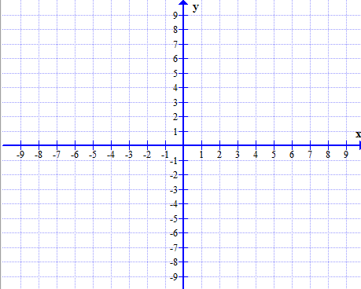
Name the following lines:
Vertical Graphs
x = -6
x = -3
x = 3
The gradient of these graphs are undefined

Slide 7
Name the following lines:
Horizontal Graphs
y = 3
y = -3
y = -5
The gradient of these graphs are zero

